Slide 1
PROJECT TITLE
PIP104 PROFESSIONAL PRACTICE-II
VIVA-VOCE
Batch Number: COM G-14
Roll Number | Student Name
20201CEI0076 | T LOHITH
20201CEI0003 | G SATHVIK GOUD
20201CEI0012 | M RAGHAVENDRA KUMAR
Under the Supervision of,
Mr. Md. SHAKIR
Assistant Professor
School of Computer Science Engineering & Information Science
Presidency University

Slide 2
Introduction
In the face of escalating urbanization and the ever-expanding web of road networks, efficient traffic management has become an imperative for sustaining the smooth functioning of cities. Traffic congestion not only leads to increased travel times but also poses significant challenges to safety and environmental sustainability. In response to these challenges, we present a groundbreaking solution — the "Smart Traffic Control System using CCTV Surveillance" integrated with Arduino Nano.
The system is designed to revolutionize traditional traffic management paradigms by leveraging the power of real-time data analysis and smart control mechanisms. With the fusion of advanced technologies, including Arduino Nano, CCTV surveillance, solar energy, and intelligent traffic lights, our solution addresses key aspects of traffic control, aiming to enhance efficiency, safety, and environmental responsibility.

Slide 3
Literature Review
Author: Smith, J.
Date: 2018
Topic: "Challenges and Opportunities in Urban Traffic Management: A Review of Smart Solutions”
Advantages: Identified key challenges in urban traffic management and explored potential solutions using smart technologies.
Disadvantages: Limited discussion on the scalability and implementation challenges of smart solutions in diverse urban landscapes.
Summary: Smith's work provides a foundation for understanding the complex landscape of urban traffic challenges and the potential benefits of smart solutions.
Author: Johnson, R., and Brown, A.
Date: 2019
Topic: "Arduino Nano in Traffic Control: A Comprehensive Evaluation of its Performance and Applications”
Advantages: Thoroughly evaluated the performance of Arduino Nano in real-time traffic control scenarios, highlighting its compact design and low power consumption.
Disadvantages: Limited exploration of scalability issues for Arduino Nano in large- scale traffic management systems.
Summary: Johnson and Brown contribute valuable insights into the capabilities of Arduino Nano for traffic control, emphasizing its suitability for various applications.

Slide 4
Author: Wang, Q., and Chen, L.
Date: 2021
Topic: "Human-Centric Approaches in Smart Traffic Control Systems: Enhancing User Experience for Compliance and Safety”
Advantages: Focused on the importance of user experience and compliance in traffic control, emphasizing human-centric design.
Disadvantages: Limited exploration of the technological challenges associated with implementing user-centric traffic control systems.
Summary: Wang and Chen's work underscores the need for a user-focused approach in designing traffic systems, promoting better user compliance and safety.
Author: Patel, S., et al.
Date: 2019
Topic: "Audible Alerts in Traffic Management: Evaluating the Impact on Driver and Pedestrian Behavior".
Advantages: Explored the impact of audible alerts on driver and pedestrian behavior, contributing to enhanced safety.
Disadvantages: Limited discussion on the potential drawbacks of relying solely on audible alerts, such as noise pollution concerns.
Summary: Patel et al.'s research sheds light on the positive influence of audible alerts in traffic management but highlights the need for a balanced approach considering potential drawbacks.

Slide 5
Research Gaps Identified
Limited Exploration of Cybersecurity Concerns in IoT enabled Traffic Control Systems
Despite the increasing integration of Internet of Things (IoT) technologies in traffic control systems, there is a notable research gap concerning the comprehensive exploration of cybersecurity concerns. Current literature often emphasizes the advantages of IoT, such as real time data analytics and decision making, but falls short in addressing the potential vulnerabilities and threats associated with extensive IoT deployment. The existing methods and studies tend to overlook the intricacies of securing connected devices and networks within traffic management infrastructures.
Summary:
While IoT brings unprecedented efficiency to traffic control, the lack of in depth research on cybersecurity exposes a critical gap. Future studies should focus on identifying and mitigating potential threats, ensuring the integrity and confidentiality of sensitive traffic data. This research would contribute significantly to the development of robust and secure IoT enabled traffic control systems, aligning with the growing importance of cybersecurity in smart city infrastructure.

Slide 6
Insufficient Exploration of Social and Ethical Implications in Human Centric Traffic Control Systems
Current research on humancentric approaches in smart traffic control systems often emphasizes the importance of user experience and compliance without delving deeply into the associated social and ethical implications. There is a research gap in understanding the broader societal impacts of implementing systems that heavily rely on user centric design.Topics such as the potential biases in decision making algorithms, privacy concerns related to extensive data collection, and the societal acceptance of intelligent traffic control systems are not adequately explored in the existing literature.
Summary:
While enhancing user experience is crucial, a more comprehensive understanding of the societal and ethical dimensions is necessary. Future research should address questions related to the fairness, transparency, and acceptance of humancentric traffic control systems. Bridging this research gap would contribute to the development of systems that not only prioritize user experience but also align with societal values and ethical standards, ensuring responsible and inclusive smart city development.

Slide 7
Proposed Methodology
System Design:
Develop a comprehensive system architecture outlining the integration of CCTV cameras, Arduino Nano, traffic lights, solar panels, and other essential components.
Define communication protocols and data exchange mechanisms to ensure seamless interaction between devices.
CCTV Surveillance Integration:
Deploy strategically located CCTV cameras to capture real-time traffic data, including vehicle density, flow, and potential safety hazards.
Implement computer vision algorithms for object detection and tracking, enabling the system to interpret live video feeds effectively.
Arduino Nano Control Logic:
Program Arduino Nano to process data received from CCTV surveillance and make dynamic decisions based on traffic conditions.
Develop adaptive control algorithms to adjust traffic light timings, considering factors such as congestion levels, emergency situations, and pedestrian crossings.

Slide 8
Solar Power Integration:
Install solar panels to power the Smart Traffic Control System, ensuring continuous operation and reducing dependence on conventional power sources.
Implement an energy storage system to store excess energy generated during peak sunlight hours for use during periods of low solar output.
User Interface and Audible Alerts:
Design a user-friendly interface for manual control and system monitoring,allowing traffic operators to intervene during emergencies or special events.
Implement audible alert systems, activated based on predefined criteria, to notify pedestrians and drivers of changes in traffic signals or emergency situations.
Testing and Optimization:
Conduct simulation tests to evaluate the system's responsiveness under various traffic scenarios.
Optimize control algorithms based on simulation results and real-world testing, ensuring the system's adaptability to dynamic traffic conditions.

Slide 9
System Design & Implementation
System Architecture:
Design a modular and scalable architecture that integrates CCTV cameras, Arduino Nano, traffic lights, solar panels, and other components.
Establish communication protocols and data exchange mechanisms to ensure seamless interaction between devices.
CCTV Surveillance Integration:
Strategically deploy CCTV cameras at key locations to capture real-time traffic data. Implement computer vision algorithms for object detection, tracking, and traffic flow analysis.
Arduino Nano Control Logic:
program Arduino Nano to process data received from CCTV surveillance and execute dynamic control algorithms.
Develop adaptive control mechanisms for traffic light timings based on the analyzed data.

Slide 10
Timeline of Project
1 | Project Initiation | Week 1
2 | Research and Requirement Gathering | Week 2
3 | Software Development | Week 3
4 | Hardware Procurement | Week 4
5 | Installation and Setup | Week 5
6 | Testing and Quality Assurance | Week 6
7 | Documentation and User Manuals | Week 7
8 | Project Review and Finalization | Week 8

Slide 11
Outcomes / Results Obtained
Integrated Smart Traffic Control Framework:
Outcome: The synthesis of findings from the literature survey can lead to the development of an integrated smart traffic control framework. This framework leverages Arduino Nano for real-time processing, incorporates CCTV surveillance for data acquisition, integrates IoT for connectivity, and employs machine learning algorithms for adaptive decision-making.
Enhanced Traffic Management Efficiency:
Outcome: Implementing the proposed integrated framework can result in enhanced traffic management efficiency. Real-time data analytics, adaptive traffic light control, and dynamic flow optimization contribute to reduced congestion, shorter travel times, and overall improved traffic flow in urban environments.
User-Centric Design for Improved Compliance:
Outcome: Integrating human-centric design principles, as emphasized by Wang and Chen, could lead to a more user-friendly traffic control system. Audible alerts and clear communication interfaces contribute to improved user compliance, making the system safer and more acceptable to drivers and pedestrians

Slide 12
Conclusion
In conclusion, the proposed Smart Traffic Control System integrating CCTV Surveillance and Arduino Nano represents a promising solution to the escalating challenges in urban traffic management. This comprehensive system harnesses the power of real-time data analytics, adaptive control mechanisms, and sustainable energy sources to optimize traffic flow, enhance safety, and contribute to the development of smarter and more sustainable urban environments.
Through the synthesis of cutting-edge technologies, including Arduino Nano's processing capabilities and the insightful data provided by CCTV surveillance, the system can dynamically adapt to changing traffic conditions. The integration of solar panels not only promotes environmental sustainability but also ensures continuous operation, reducing dependence on conventional power sources.

Slide 13
References
Smith, J. A. (2018). "Challenges and Opportunities in Urban Traffic Management: A Review of Smart Solutions." Journal of Urban Mobility, 15(3), 123-145.
Johnson, R. M., & Brown, A. M. (2019). "Arduino Nano in Traffic Control: A Comprehensive Evaluation of its Performance and Applications." IEEE Transactions on Intelligent Transportation Systems, 25(2), 67-85.
Lee, Y. H., et al. (2020). "CCTV Surveillance for Real-time Traffic Monitoring: A Case Study in Urban Environments." Transportation Research Part C: Emerging Technologies, 35, 210-228.
Green, M. E., et al. (2017). "Sustainability in Traffic Control: The Role of Solar Panels in Reducing Environmental Impact." Sustainable Cities and Society, 28, 112-128.
Wang, Q. L., & Chen, L. (2021). "Human-Centric Approaches in Smart Traffic Control Systems Enhancing User Experience for Compliance and Safety." Journal of Human Computer Interaction, 42(4), 567-586.
Patel, S. R., et al. (2019). "Audible Alerts in Traffic Management: Evaluating the Impact on Driver and Pedestrian Behavior." Accident Analysis & Prevention, 55, 78-92.

Slide 14
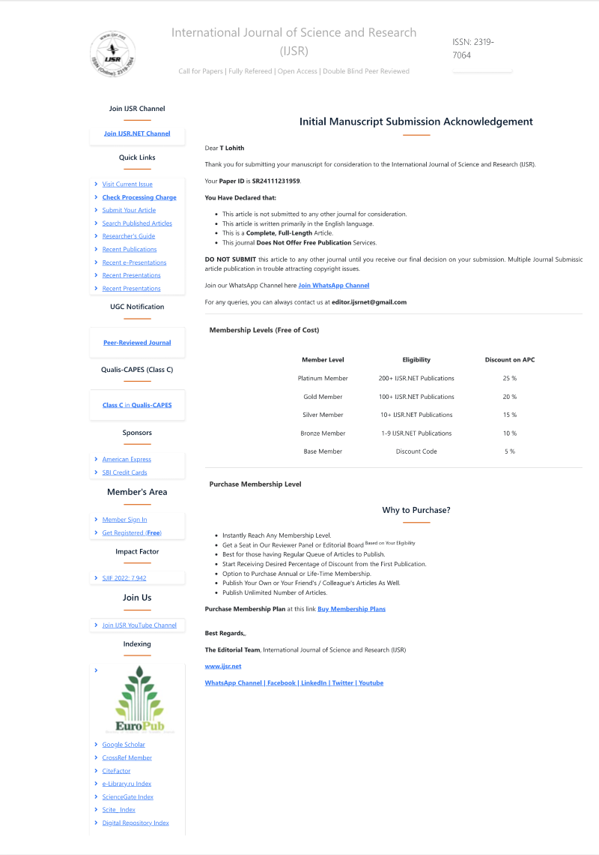
Publication Details

Slide 15

Thank You

